Slide 1
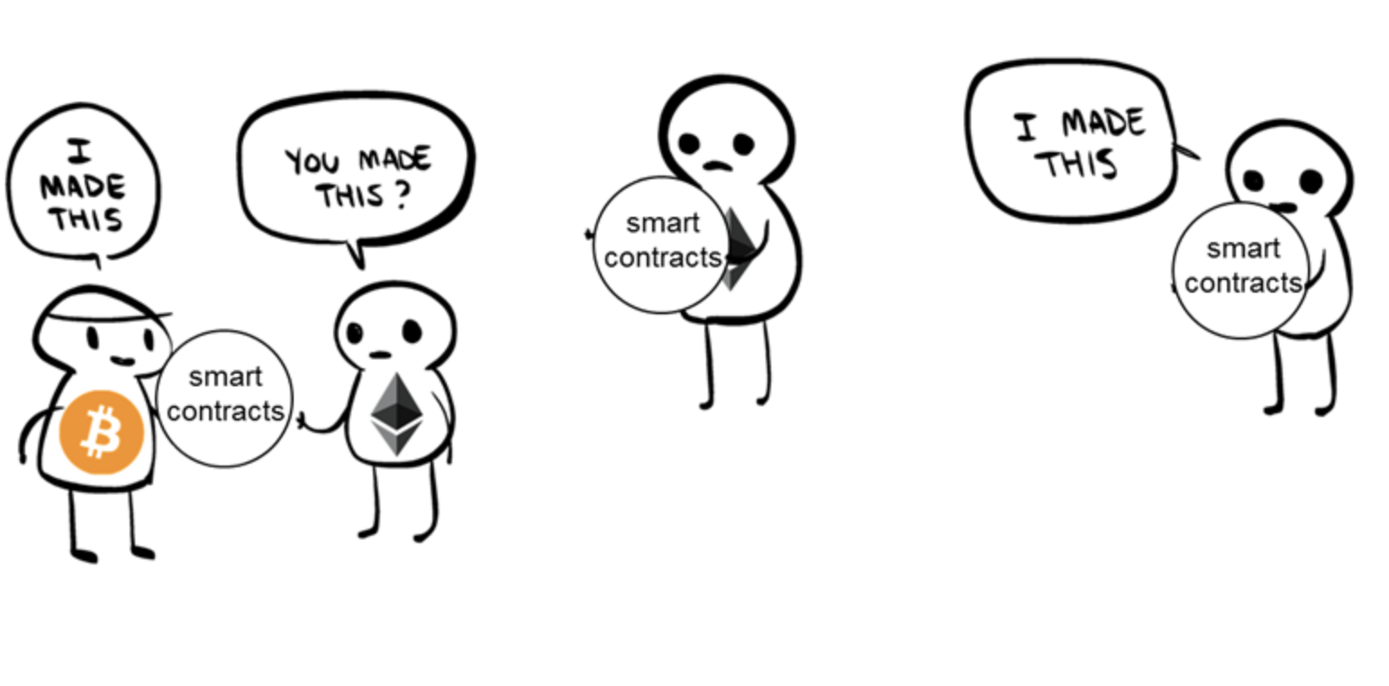
Forks, Alts, and ICOs
Many ways to lose a lot of Money

Slide 2
I decided this Powerpoint wasn’t worth completing.
Don’t buy Alts unless you acknowledge it’s gambling. There are many good reasons why not.

Slide 3
Why no Alts?
In a free market, there only need be 1 money: the most liquid good.
All tokens are simply intermediaries for money.
We don’t need the world on a blockchain (yet/ever)
Bitcoin is conservative and deliberate. Security and trust are vital for a stable currency. Most alts move fast and break things.
Bitcoin’s distribution was and is as fair as possible. https://blog.picks.co/bitcoins-distribution-was-fair-e2ef7bbbc892
It is the most decentralized network: Satoshi’s gone.

Slide 4
Hard Forks vs. Soft Forks
Since Bitcoin is a consensus-driven network, it is adaptable. The Protocol can be updated in two ways: Hard Forks and Soft Forks.
Soft Forks are optional and a miner or node runner can run the new software without creating a separate chain. Old and new software can run simultaneously.
Hard Forks split the chain into two. However, both retain all the blocks before the split.
What makes an update a soft or hard fork is mostly technical.

Slide 5
The Segwit 2x Hardfork
In August of 2017, BCash split from BTC...
What is SegWit

Slide 6
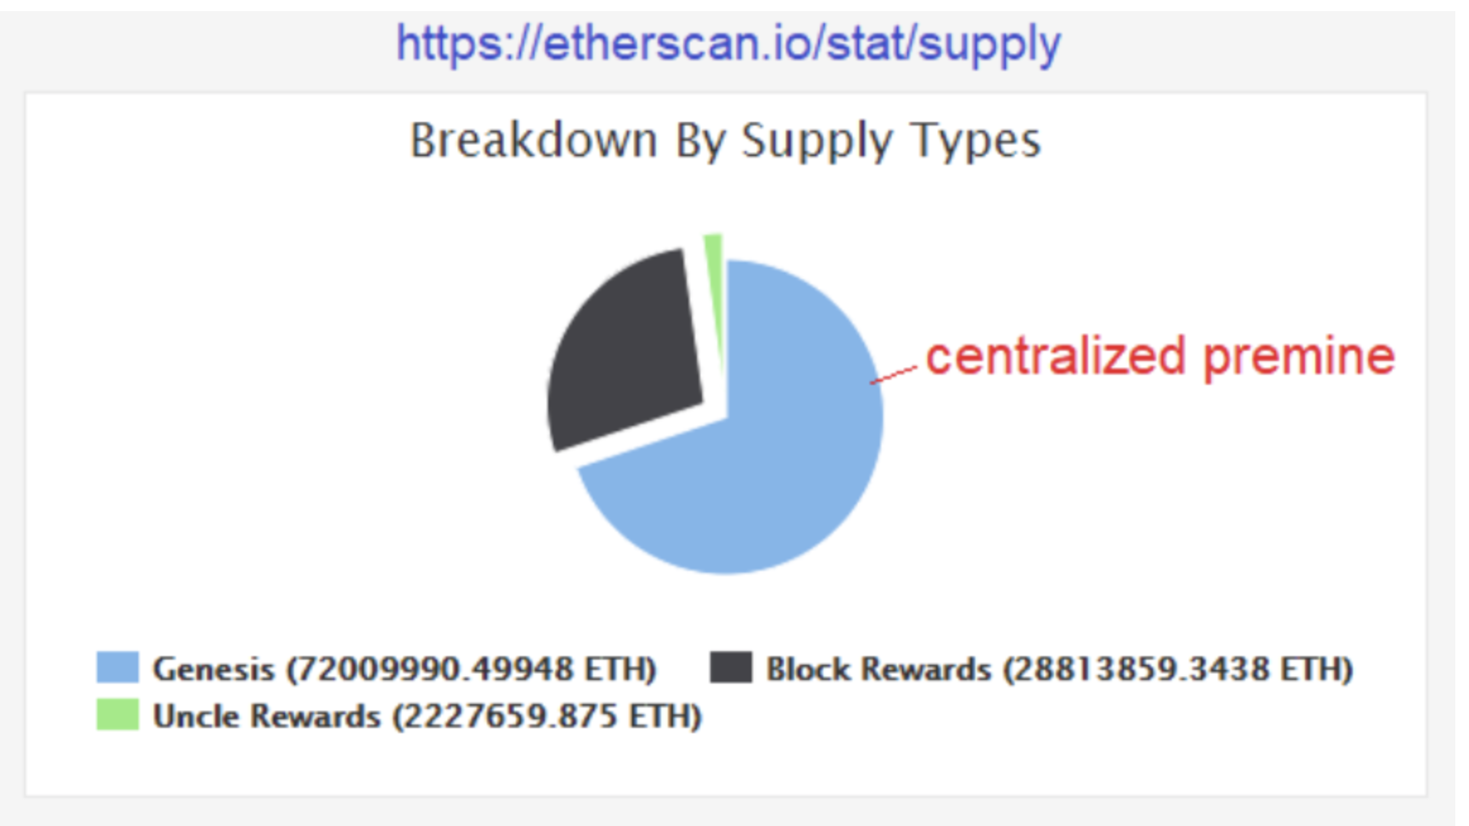
ICOs and Pre-mines
Never buy an ICO, or any coin with Pre-mines.

Slide 7
AltCoins
Coinmarketcap.com
Ethereum: Smart Contracts and Turing Computers
ETC v. ETH
Bitcoin Cash: Segwit 2x
ABC v. SV
Monero: Fungibility and Privacy
Litecoin:
TRON:
IOTA: Total Decentralization

